Slide 1
MODULE 4
MODULE 4
Programming Tools

Slide 2
Evolution of embedded programming tools

Slide 3
HISTROY- Evolution of embedded programming tools
Early Days - Hand-Coding and Assembly Language (1950s-1970s):
In the early days of embedded systems, programming was done primarily through hand-coding directly in machine language or assembly language. Programmers wrote code specific to the hardware architecture of the embedded system, resulting in highly efficient but often complex and error-prone code.

Slide 4
Introduction of High-Level Languages (1970s-1980s):
The introduction of high-level languages like C provided a more abstract and portable way to program embedded systems. Cross-compilers were developed to translate code written in high-level languages to machine code for the target hardware architecture

Slide 5
Integrated Development Environments (IDEs) (1980s-1990s):
Integrated Development Environments (IDEs) started to emerge, providing programmers with tools for editing, compiling, debugging, and deploying code within a unified environment. IDEs such as Turbo C, Borland C++, and Keil uVision became popular for embedded development.

Slide 6
Real-Time Operating Systems (RTOS) (1990s-Present):
As embedded systems became more complex and required multitasking capabilities, Real-Time Operating Systems (RTOS) gained prominence. RTOSes like VxWorks, FreeRTOS, ThreadX, and µC/OS provided scheduling, task management, and inter-process communication services for embedded applications

Slide 7
Hardware Abstraction Layers (HALs) and Middleware (2000s-Present):
Hardware Abstraction Layers (HALs) were developed to provide a standardized interface to hardware peripherals, enabling portability across different hardware/Network platforms.

Slide 8
Middleware components and libraries became widely used to abstract common functionalities such as networking, communication protocols, and file systems, reducing development time and effort.

Slide 9
Advanced Debugging and Optimization Tools (2000s-Present):
Advanced debugging tools such as JTAG( Joint Test Action Group) debuggers, in-circuit emulators, and logic analyzers became essential for diagnosing and fixing issues in embedded systems. Profiling tools, static analyzers, and code coverage tools emerged to help optimize performance, memory usage, and reliability of embedded software

Slide 10
Model-Based Design and Simulation (2000s-Present):
Model-Based Design tools such as MATLAB/Simulink and LabVIEW were introduced, allowing developers to design, simulate, and generate code for embedded systems using graphical models. These tools facilitate rapid prototyping, system-level simulation, and automatic code generation, improving productivity and reducing time-to-market.

Slide 11
Integration with DevOps Practices (2010s-Present):
Embedded development has increasingly adopted DevOps practices, including version control, continuous integration (CI), and continuous deployment (CD). CI/CD pipelines automate the build, test, and deployment processes, enabling faster and more reliable software delivery for embedded systems.

Slide 12
Cloud-Based Development and IoT Platforms (2010s-Present):
Cloud-based development platforms and IoT frameworks have emerged, offering scalable infrastructure, data analytics, and over-the-air (OTA) update capabilities for embedded systems. These platforms enable remote development, monitoring, and management of embedded devices, particularly in IoT applications.

Slide 13
1.Embedded Software
Embedded Software is the software that controls an embedded system. All embedded systems need some software for their functioning.
Embedded software or program is loaded in the microcontroller which then takes care of all the operations that are running.

Slide 14
developing this software, a number of different tools are needed.
These tools include editor, compiler, assembler, debugger, Linker, and simulators

Slide 15
1. Editor
This is where you write the code for your embedded system.
The code is written in some programming language. The most commonly used language is C or C++ and Assembly languages.
The code written in the editor is also referred to as source code.

Slide 16
2. Compiler
Compiler is used to convert a high level language code into low level programming language..
A compiler is used when you are done with the editing part and made a source code.
The function of compiler is to convert the source code into object code.
Object code is understandable by computers as it is a low level programming language.

Slide 17
3.Assembler
The function of an assembler is to convert a code written in assembly language into machine language.
All the mnemonics and data is converted in to op codes and bits by an assembler.
computer understands binary and it works on 0 or 1, so it is important to convert the code into machine language.

Slide 18
4. Debugger
Test whether the code you have written is free from errors or not. So, a debugger is used for this testing.
Debugger goes through the whole code and tests it for errors and bugs.
It tests your code for different types of errors for example a run time error or a syntax error and notifies you wherever it occurs.

Slide 19

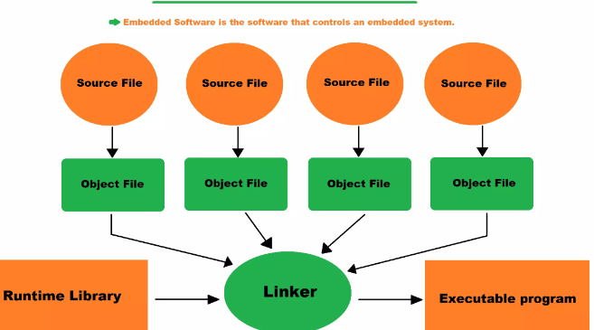

Slide 20
5. Linker
A linker is a computer program that combines one or more object code files and library files together in to executable program.
Write larger programs in to small parts and modules to make job easy and to use libraries in your program.
combined into a single file for execution, so this function requires a linker.

Slide 21
6. Libraries
A library is a pre written program that is ready to use and provides specific functionality
Arduino microcontroller comes with a number of different libraries(ex: 24LCxx) that you can download and use while developing your software.
controlling LED or reading sensor like an encoder can be done with a library.

Slide 22
7. Simulator
A simulator helps you to see how your code will work in real time.
You can see how sensors are interacting, you can change the input values from sensors, and you can see how the components are working and how changing certain values can change parameters.

Slide 23
2.Evolution of embedded programming tools
Programming Tools:
The microcontrollers can be programmed using various Programming/Development tools like Embedded Software
from Mentor Graphics, IAR Systems, Keil MicroVision from ARM Ltd., and Code Composer Studio (CCS) from Texas Instruments.

Slide 24
Introduction to Code Composer Studio:
CCS is a TexIns proprietary cross platform IDE used to convert C and assembly language code to executable for TexIns processors,
involving Digital Signal Processors, ARM, and other microcontrollers.
CCS combines editing, debugging and analysis tools into a single IDE based on Eclipse open source development tool.

Slide 25
Compilation (Build Process):CCS
CCS uses a Code Generation Tool (often called CGT) for compilation process also called as build process.
It is used to generate executables for a target device. This process takes source codes written in C, C++ and/or Assembly Language and produces executable at the output called binaries

Slide 26
After the assembly language files are generated by the compiler, an assembler converts them to relocatable object files.
These object files are linked to the runtime libraries included in the project by a linker.
The linker produces executables from these files using protocols mentioned in the command file

Slide 27
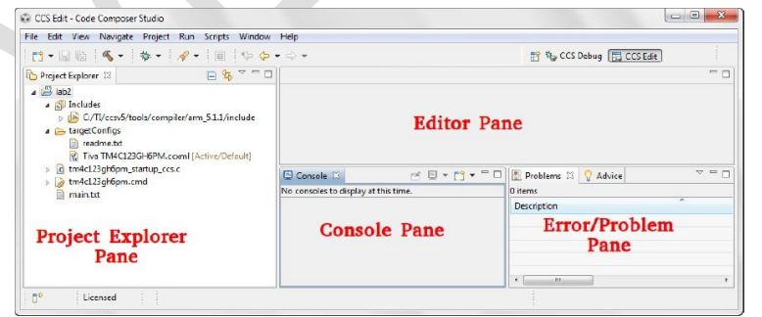

Slide 28
INTRODUCTION TO Keil SOFTWARE
Keil A Cross Compiler:
The Keil 8051 Development Tools are designed to solve the complex problems facing embedded software developers.
Keil offers an evaluation package that will allow the assembly and debugging of files 2K or less.
This package is freely available at their web site.

Slide 29
Compilers are programs used to convert a High Level Language to object code.
So if one wants to define a compiler then compiler is a program that translates source code into object code.
A cross compiler is similar to the compilers but we write a program for the target processor (like 8051 and its derivatives) on the host processors (like computer of x86)

Slide 30
Cross compiler
It means being in one environment you are writing a code for another environment is called cross development.
And the compiler used for cross development is called cross compiler.

Slide 31
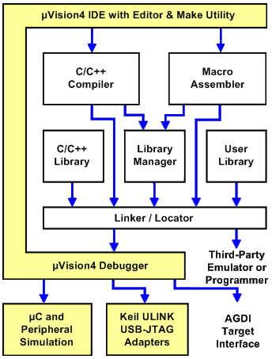

Slide 32
Keil IDE Advantages
Development of complex embedded systems completed in a fraction of the time.
Reliability is improved
Maintenance is easy
Knowledge of the processor instruction set and memory architecture is not required

Slide 33
Improved program readability
Keywords and operational functions that more nearly resemble the human thought process can be used.
Program development and debugging times are dramatically reduced

Slide 34
Existing routine can be reused in new programs by utilizing the modular programming techniques available with C.

Slide 35
Development tools provided by Keil
IDE (Integrated Development environment)
Project Manager
Simulator
Debugger
C Cross Compiler
Cross Assembler,

Slide 36
An assembler is used to assemble your 8051 assembly program
A compiler is used to compile your C source code into an object file
A linker is used to create an absolute object module suitable for your in-circuit emulator.

